Slide 1

Lebanese University
OSAMA
ZAMMAR
MOHAMMAD
ABOU
ALFOUL
OBAIDA
AMMAR

Slide 2


Introduction
The proposed project ‘Academic Registration’ is a Web Based System which automates the process of registering students in courses at the Lebanese University – Faculty of Science.
The website supports the registration of students enrolled in the Department of Computer Science, it could be adjusted and improved in the future to support the registration of students from all the Faculty of Science Departments.

Slide 3


Users involved
Faculty
of Science Admins
Computer Science Students

Slide 4








Languages and Tools Used
Front-end
Backend-end
frameworks

Slide 5

LANDING PAGE
This is the main page of the website ‘The Landing Page’ where any user on the internet can access it, get to know about the Faculty of Science at The Lebanese University.

Slide 6
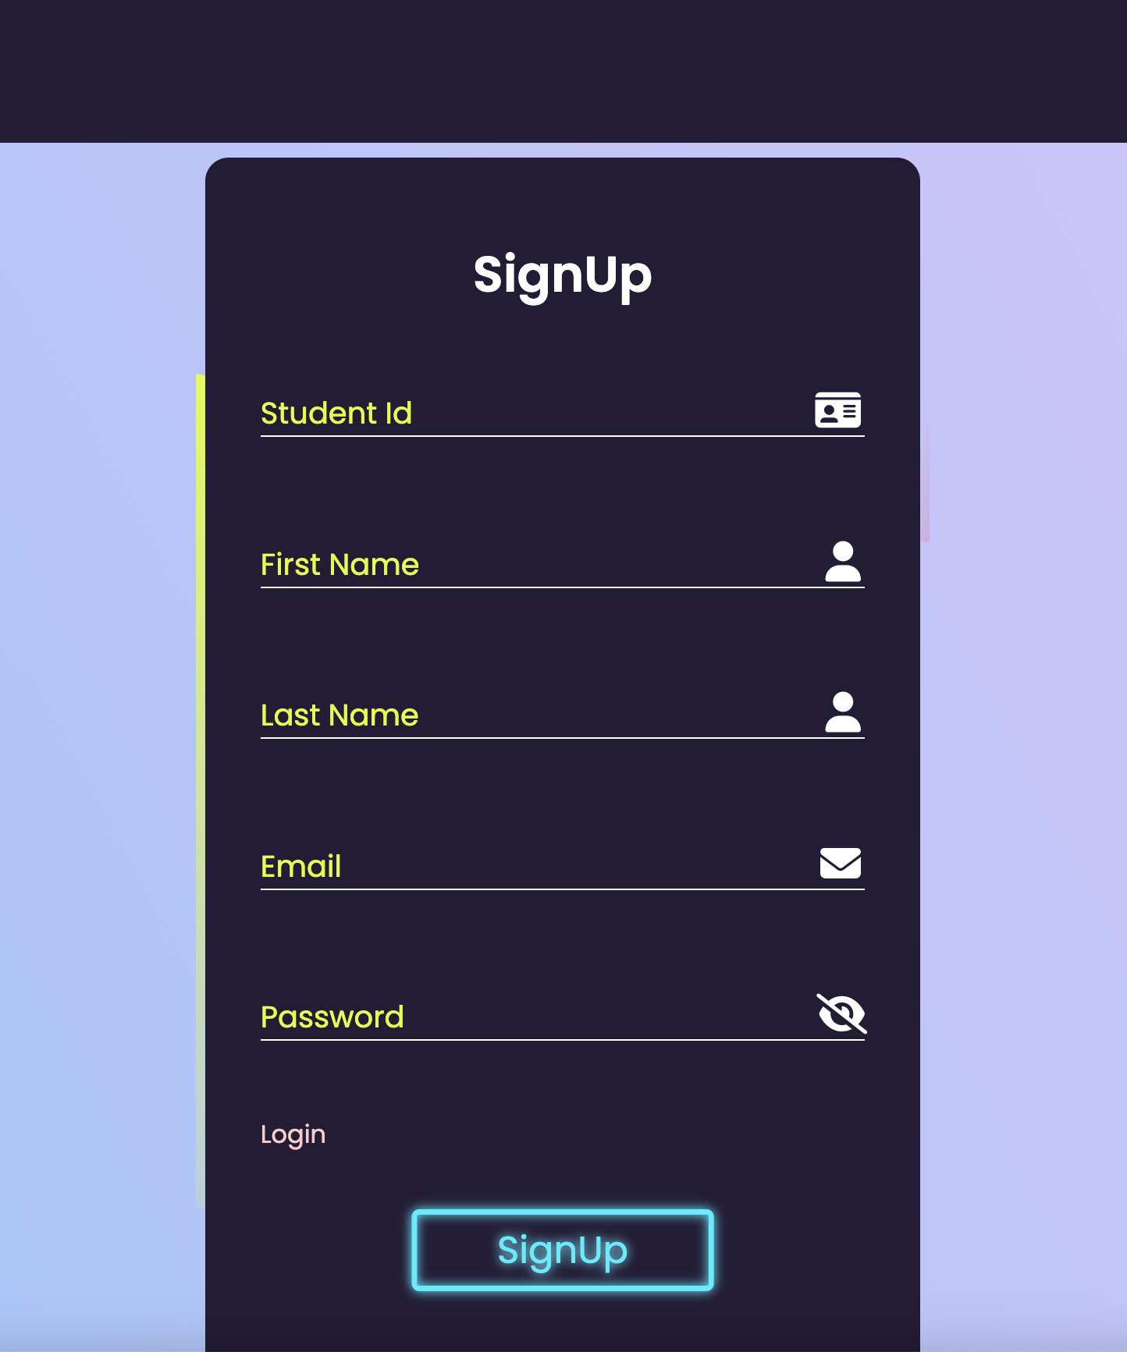
Signup Page
Mainly an admin will import the accounts of students and add them to the database. However, this functionality is added for certain cases when a student account is not imported by an admin, so later on the student can signup for an account and wait for acceptance by an admin.

Slide 7
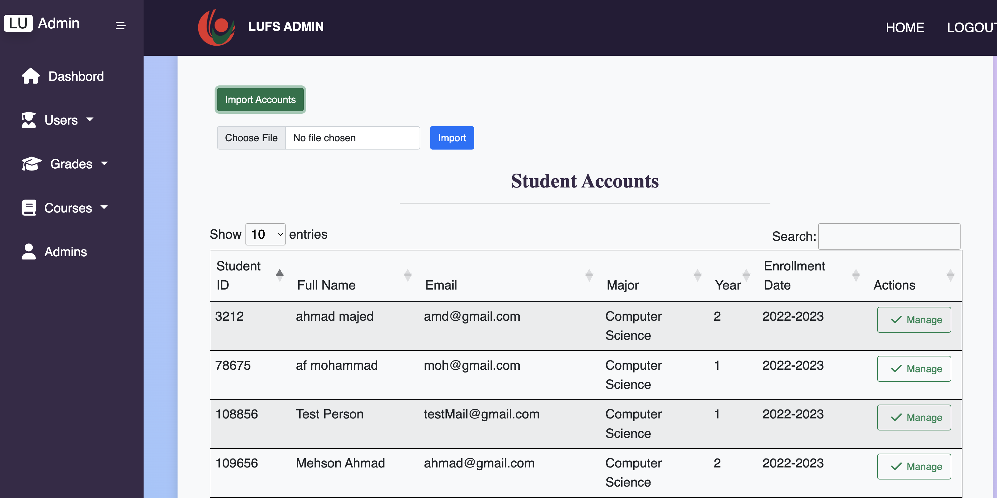
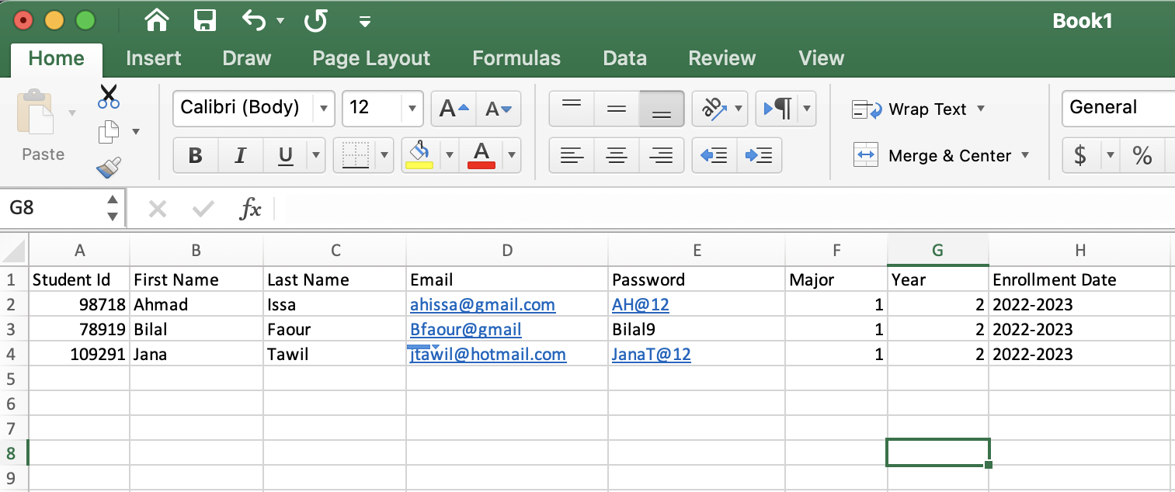
Admin Import Students Accounts
Choose excel file and import grades
An Admin can import an excel file containing students accounts with the attributes as seen in the figure below (Major = 1 Represents Computer Science, Year = 2 Represents the current year of student ‘We make accounts and add them to site starting from year 2’ , Enrollment Date represents the date when the student registered in the Lebanese University not on the site but physically at the university.

Slide 8
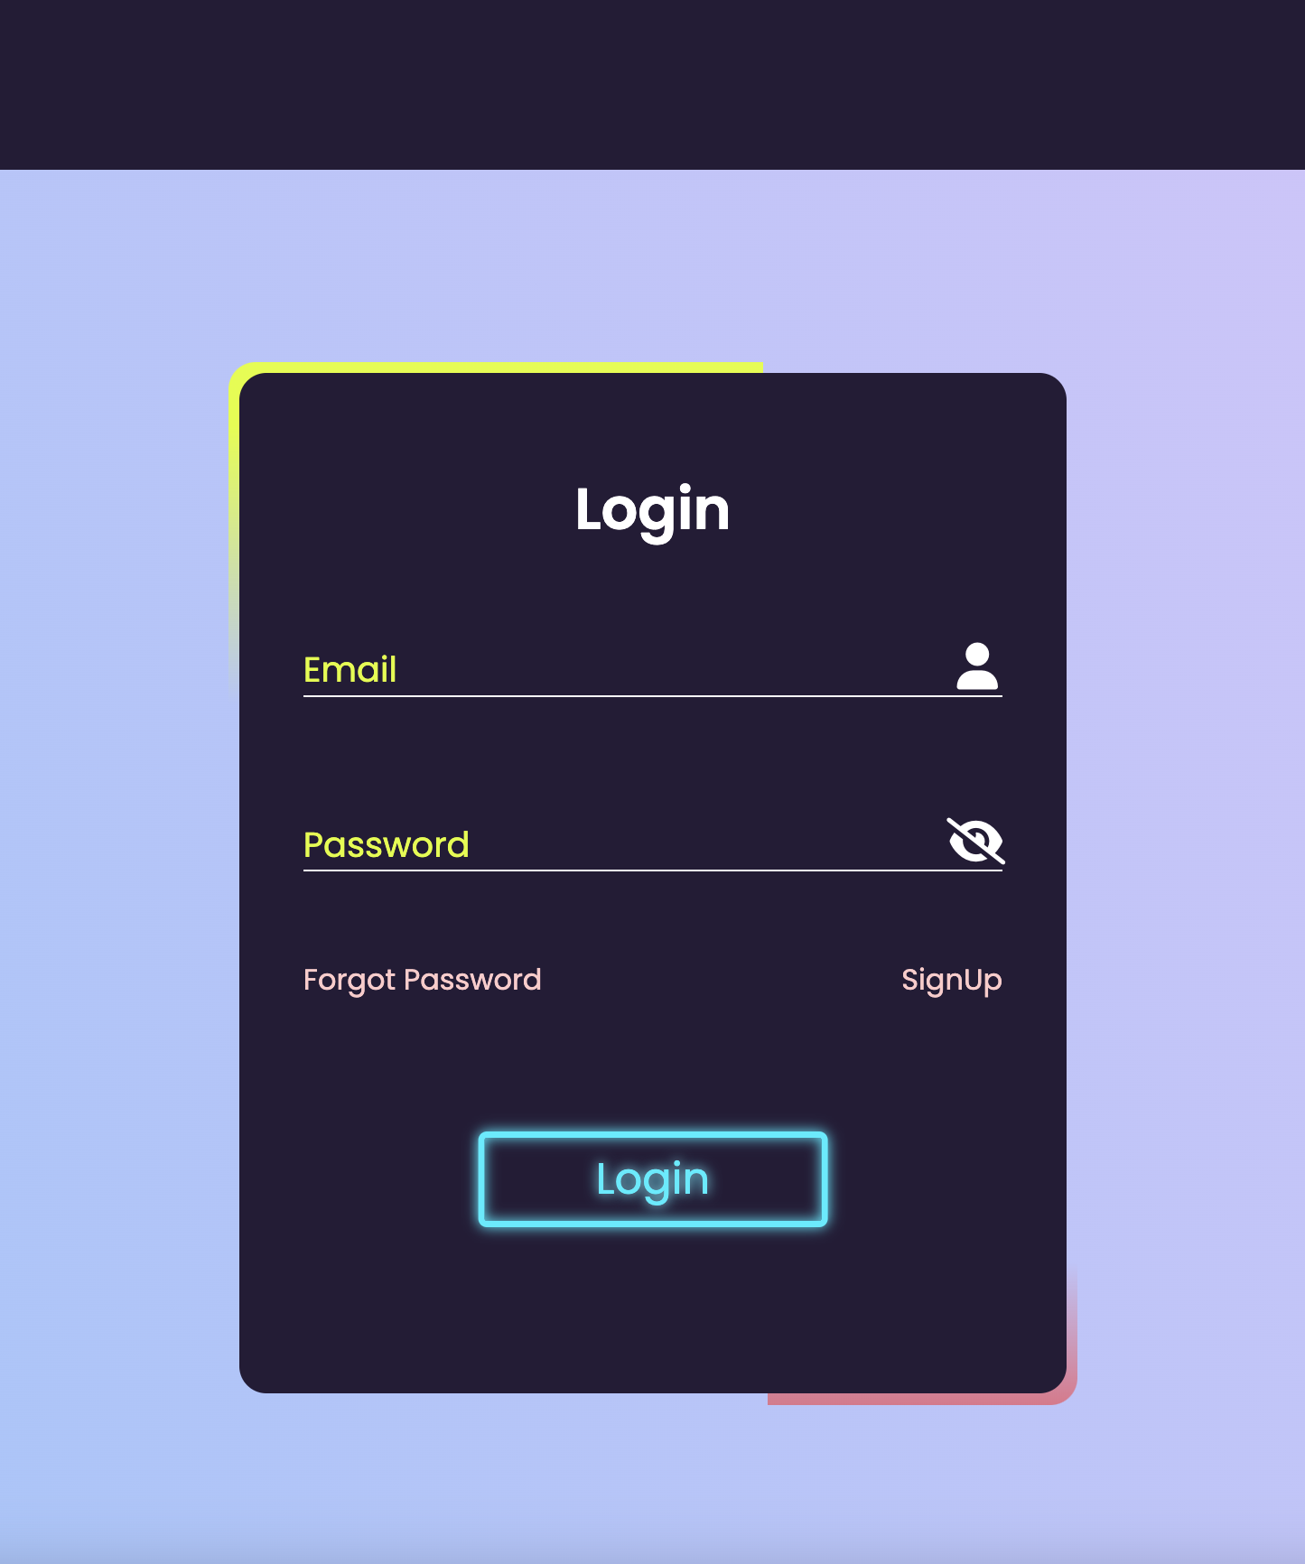
Login Page
A user will be able to login to the website if his/her credentials (email, password) exist in the database ‘Account already imported before by an admin’ or the student signed up for an account from the signup page and was accepted by an admin. Users must login using their email and password. An administrator credentials will be recognized and will be redirected to the admin panel, otherwise if the user is a a student, then will be redirected to the user-page.

Slide 9
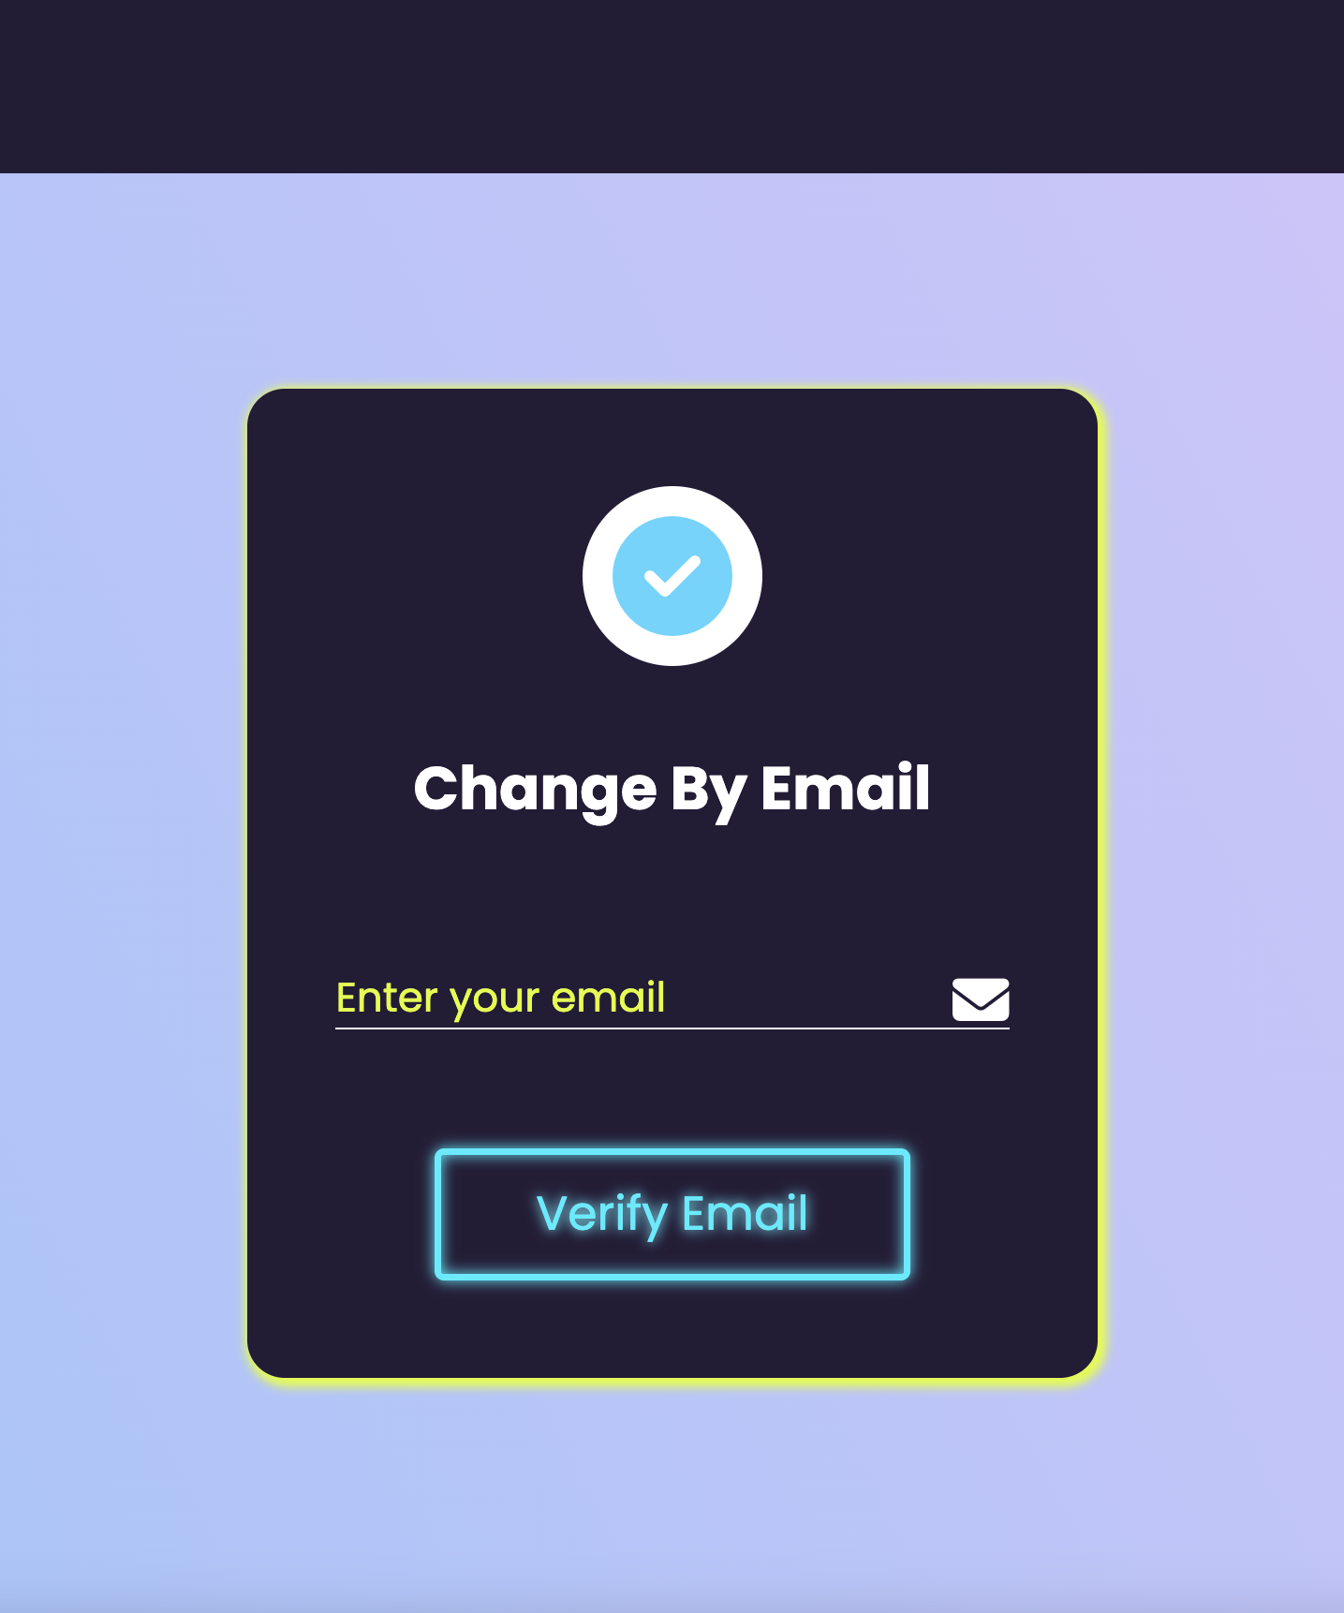
Forgot Password
Student who forgot his/her account password can request to change it.
An email verification is needed, the email used for accessing the website must be entered at this step. If the email exist in the faculty database the change password request for this email must proceed.

Slide 10
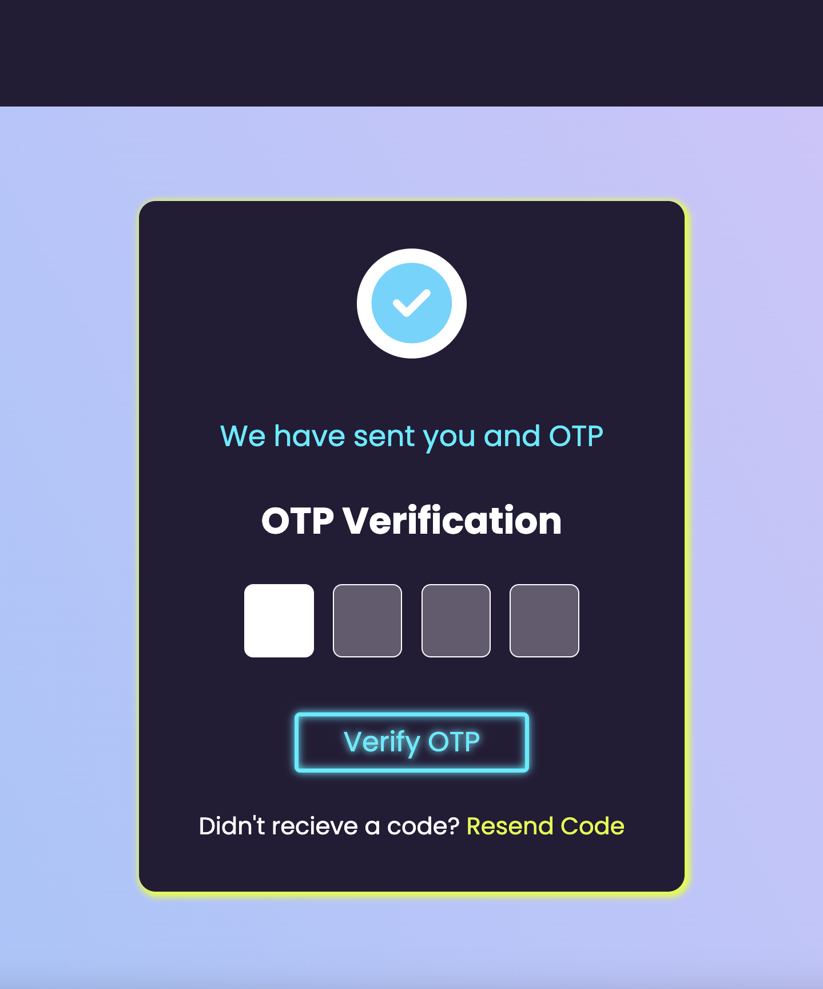
OTP Verification
An OTP verification code will be send to the email requested to change the password. If the code entered matches the OTP sent then the student will be directed to a page in order to change the account password, otherwise a ’wrong OTP code message will be shown’ .

Slide 11
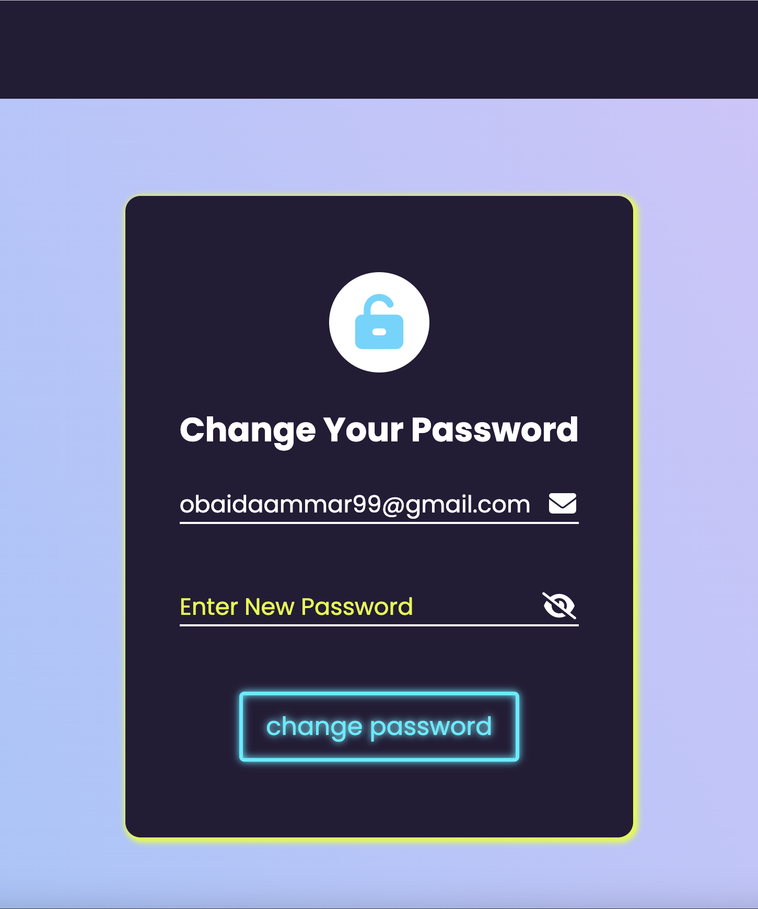
Change Password
At this step the student will be able to change the account password and will be redirected back to login page.

Slide 12
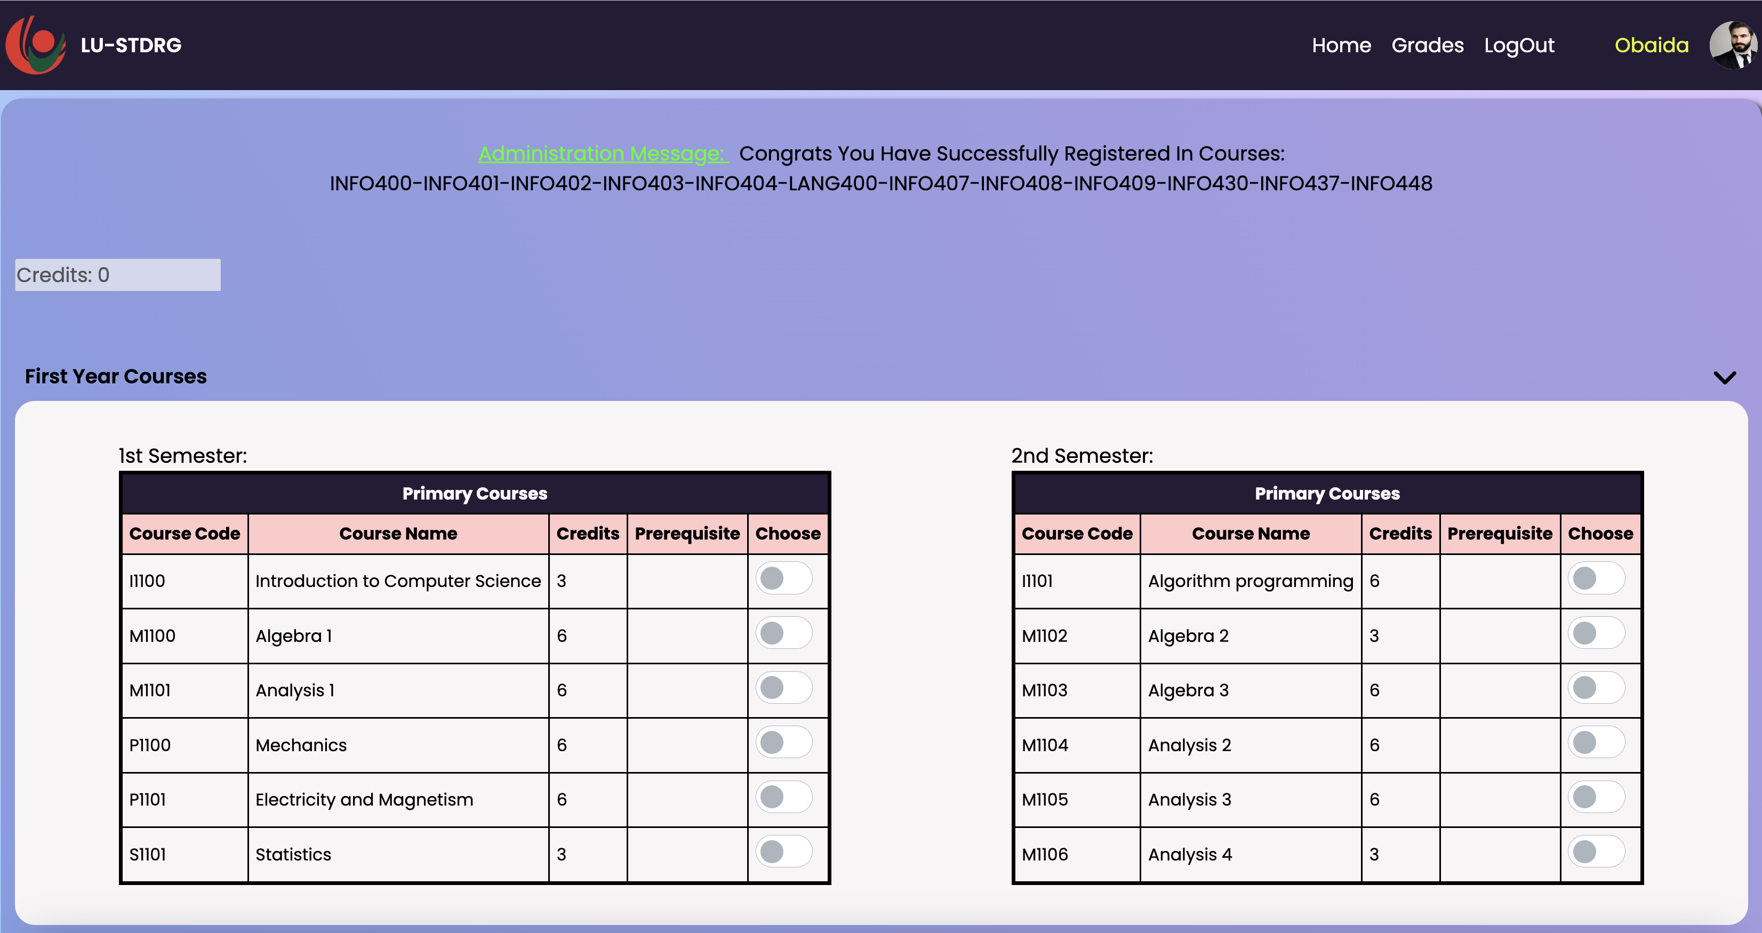
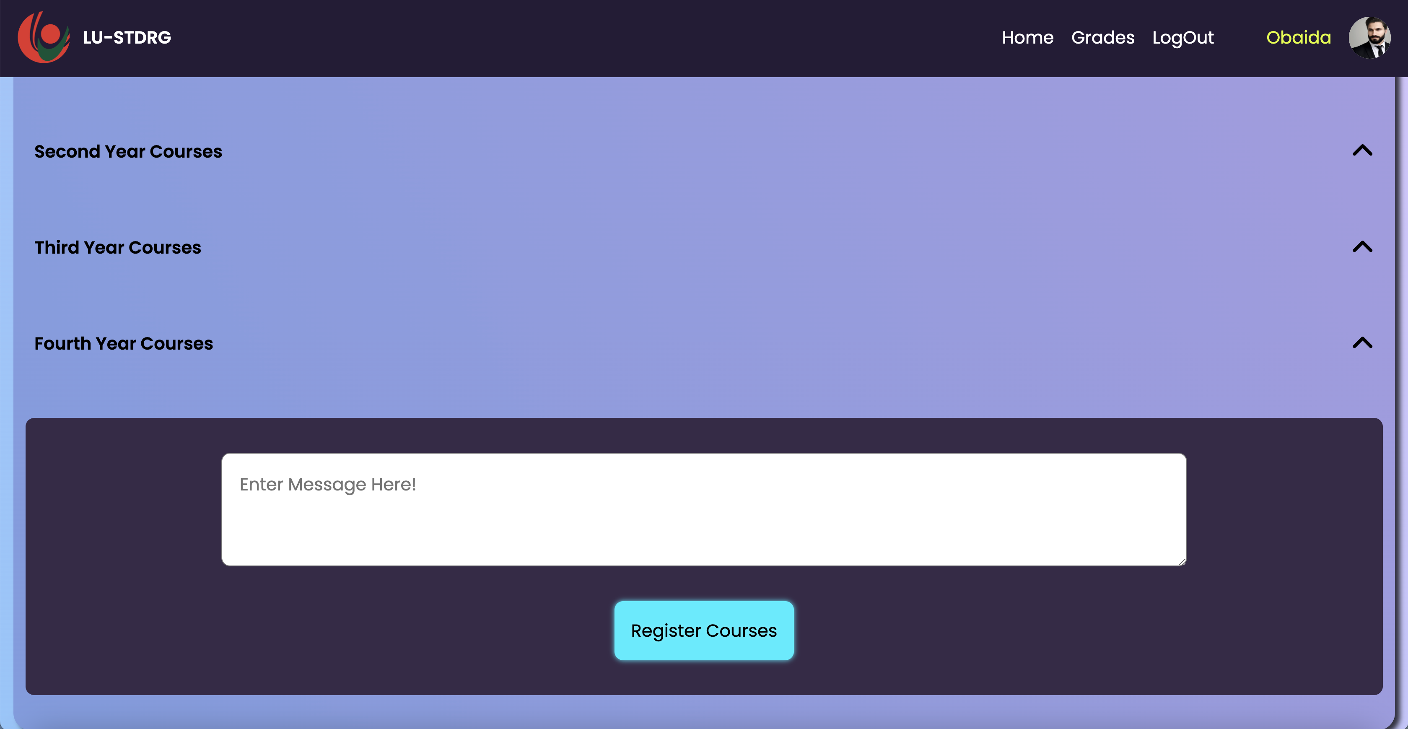
Student Page – Course Registration
List of enrolled courses after an admin acceptance to student request
This is the student page where students request to register courses. Most of the course registration restrictions are developed at the client side. A student can choose from the courses he/she is permitted to enroll in, include a message for admins incase of any inquiries and send a request to administrators to enroll in the chosen courses. Once Admins accept the student request a message will be shown at student side with the list of courses that he/she are enrolled in for this year.

Slide 13
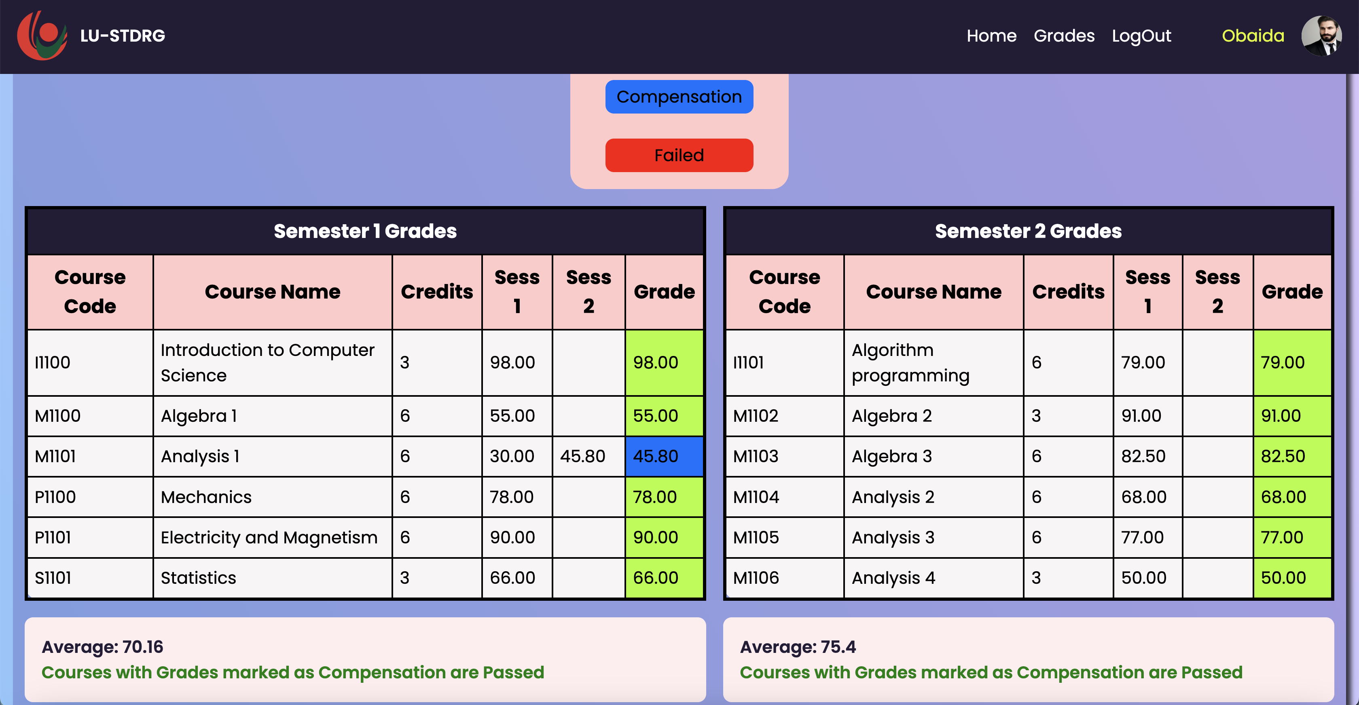
Student Grades Page
In this page student will be able to check all his/her published grades (Session 1, Session 2, and final grade) in the enrolled courses. A grade average description will be shown for each semester and the grades will be displayed in a colored way to represent the passed/compensation/failed grades.

Slide 14
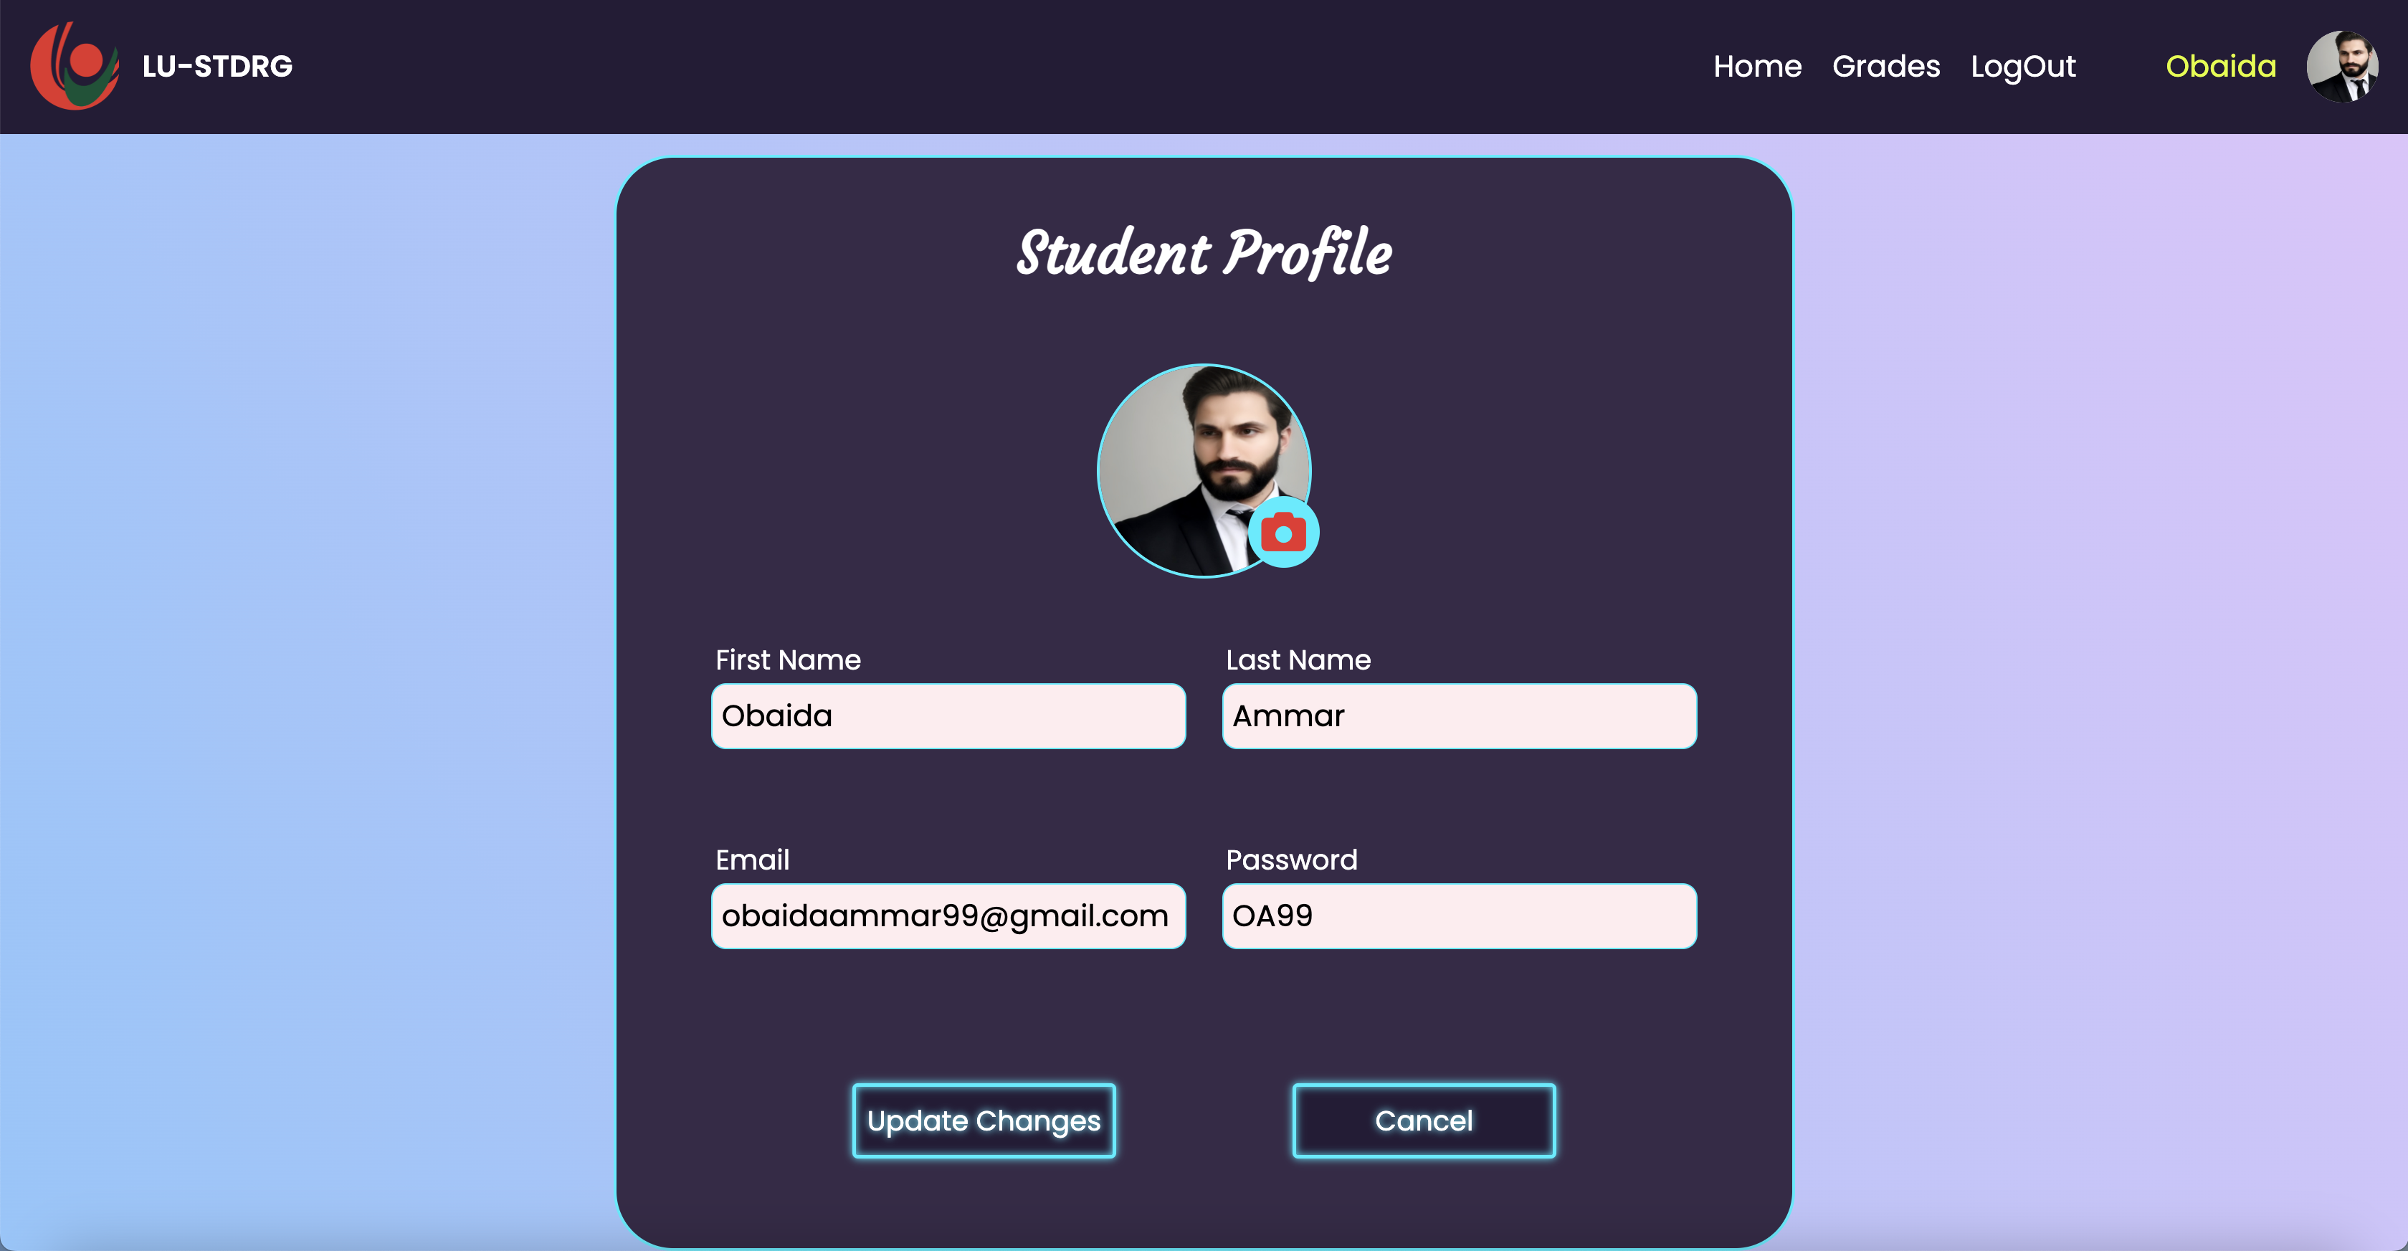
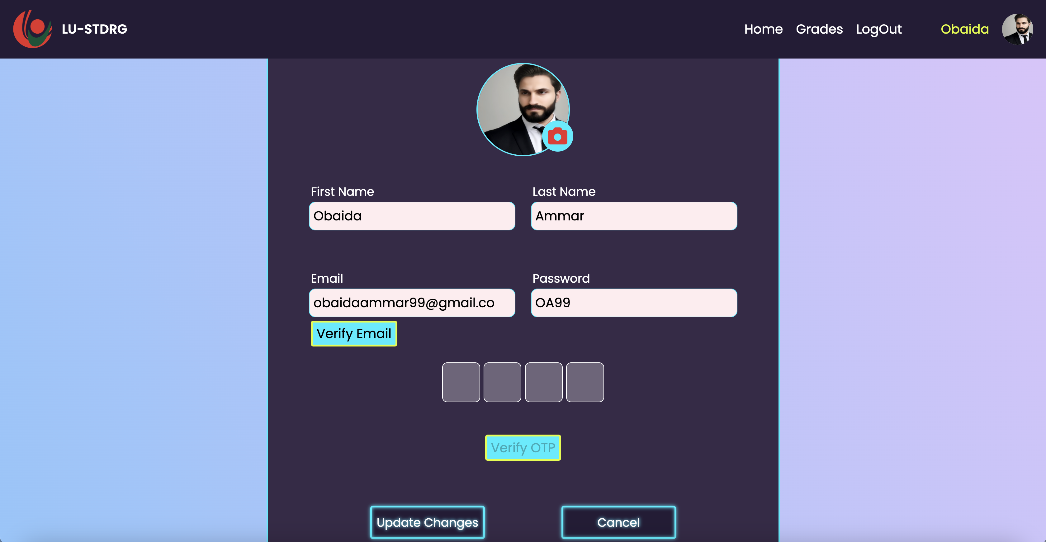
Student Profile Page
This page is accessed by the student once he/she clicks on the profile picture, student will be able to change their email or password. However, any attempt to change the email will require the student to verify that the new email is a valid one and belongs to him/her.
Verify new email

Slide 15
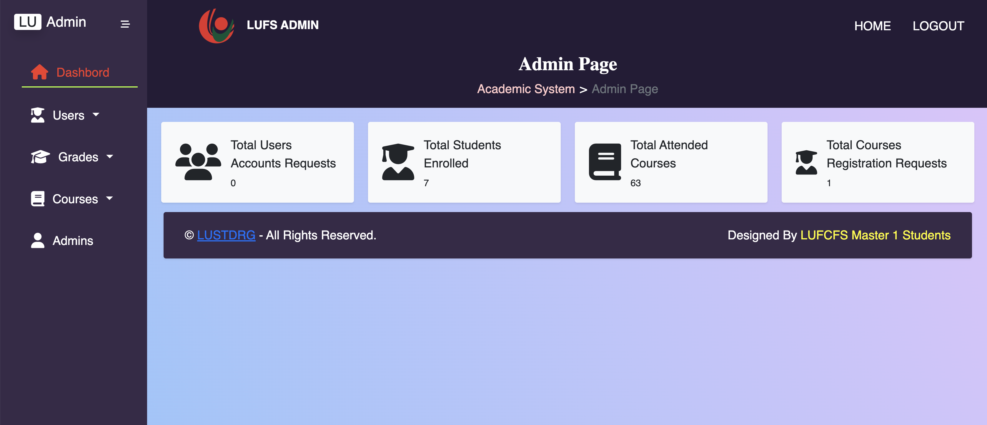
Admin Dashboard
Main admin page (Dashboard) which show statistics and descriptions about courses and students.

Slide 16
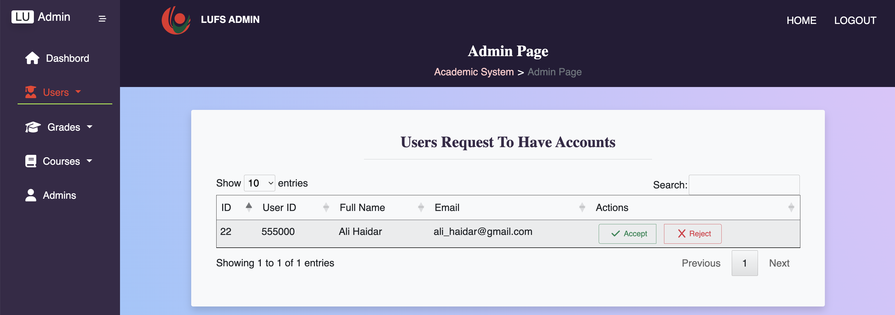
Admin Page – Student Request for account acceptance
Main Admin Page where users request to access the website (manually SignUp) will be listed in this table. Students whose credentials are valid will be accepted and he/she will have access to the website services (register courses, check grades).

Slide 17
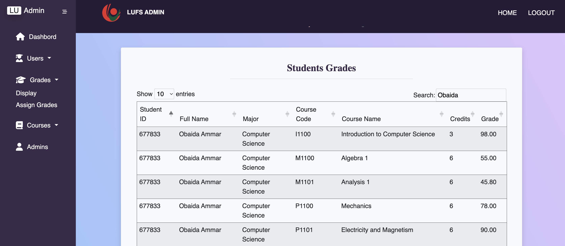
Admin Page – View Students Grades
Students Grades Display Page. An admin will be able to view all grades assigned to students in the department of Computer Science. Filtering is also used to enhance the process of retrieving the required grades.

Slide 18
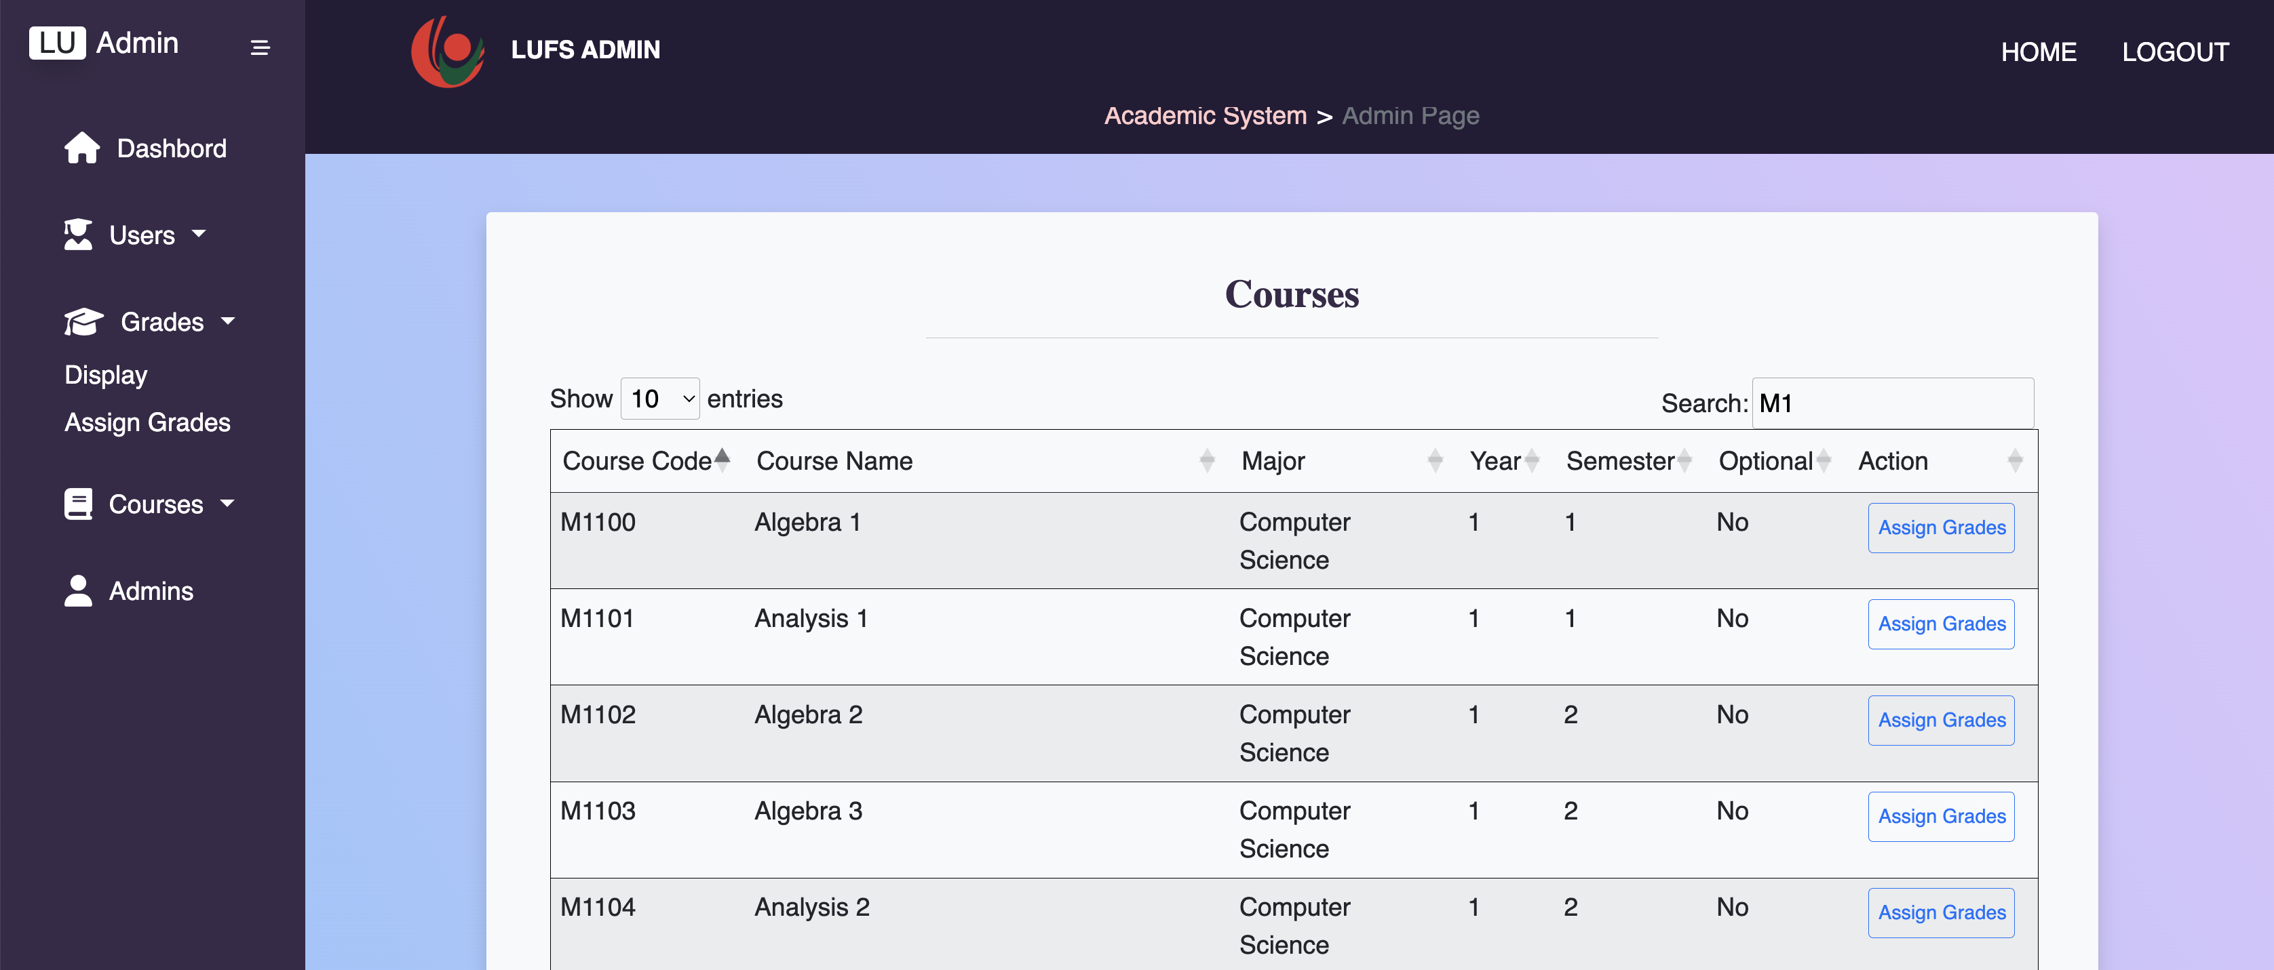
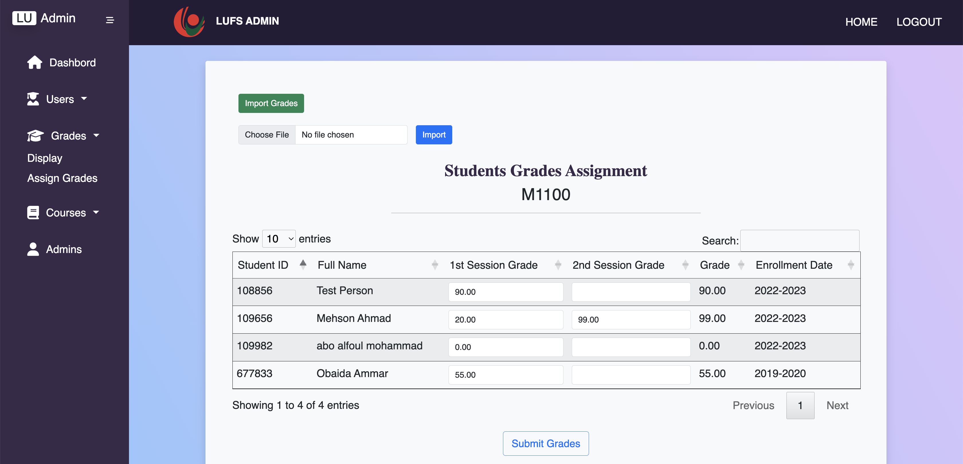
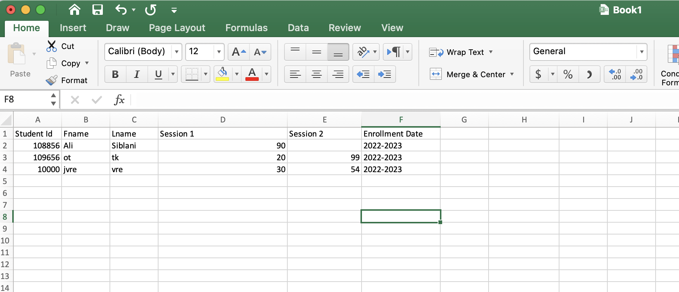
Admin Page – Import Students Grades
Students Assign Grades Page. An admin will be able to import students grades as an excel file of a particular chosen course
Choose an excel file of students grades in the chosen course and import the grades
The grade excel file must be like this. Each course must have a list of students grades. Session 1, Session 2 Represent the grades of students in Each session. Enrollment date represents the date of enrollment in this course

Slide 19
Admin Page – Assign Students Grades
Students Assign Grades Page. An Admin can also assign grades to each student separately rather than importing an excel file for the entire students
Assign grades to each student and ‘Submit Grades’

Slide 20
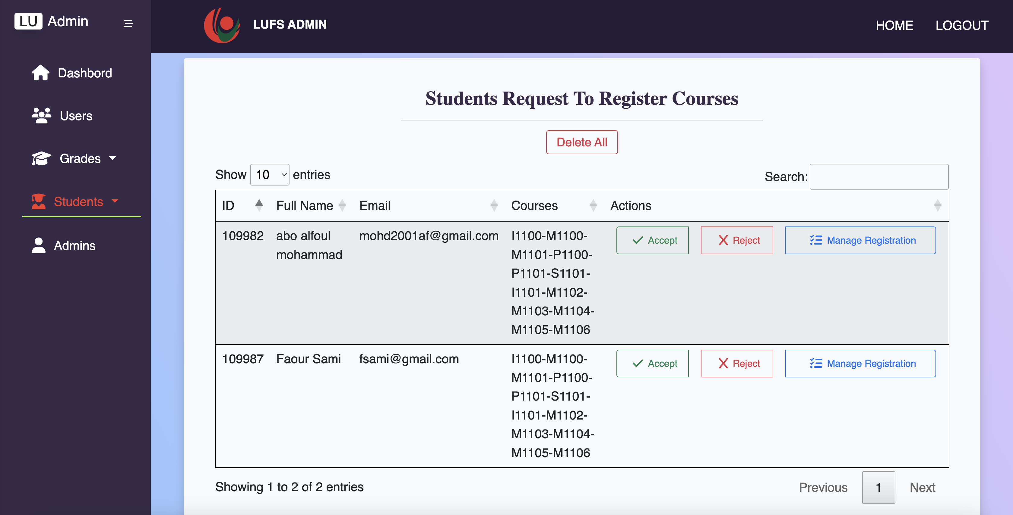
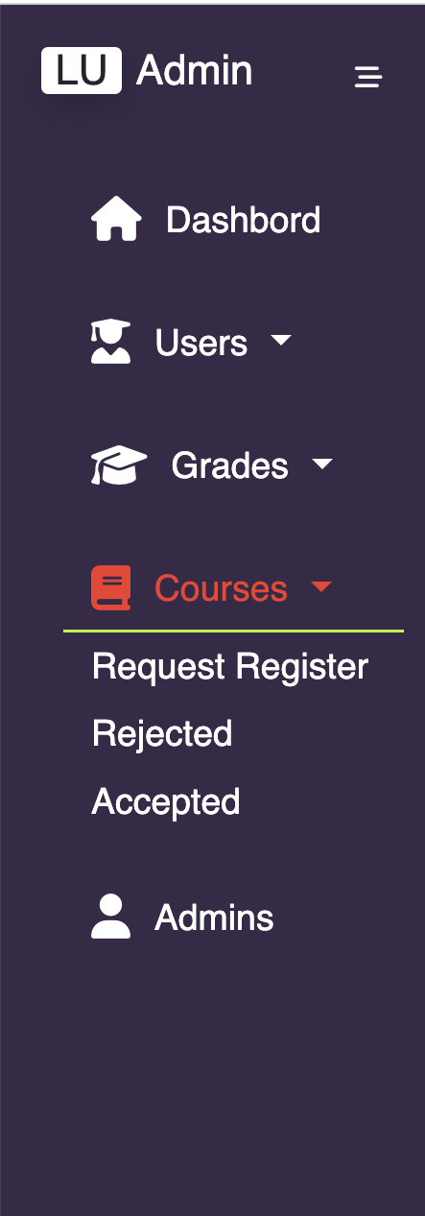
Admin Page – Student Request to Enroll in Courses
Students who requested to enroll in courses will be shown in this table. An admin could Accept/Reject or Manage the registrations
Admin must delete all course registration requests at the end of the year to allow students to apply for courses the next year

Slide 21
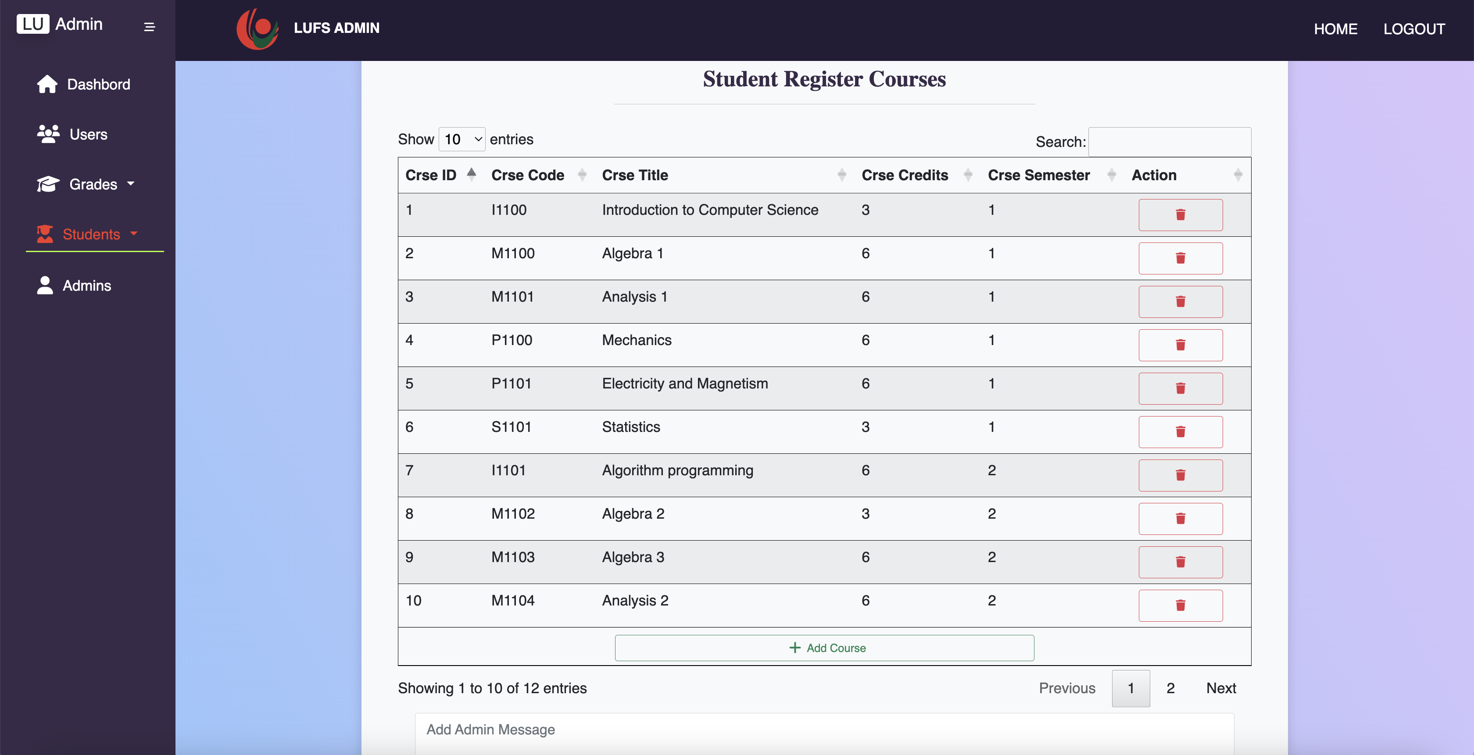
Admin Page – Manage Student Course Registration
An admin can manage students enrollment in courses by deleting him/her from a chosen course due to some criteria or even add him to a course that is not chosen by the student due to some restrictions

Slide 22
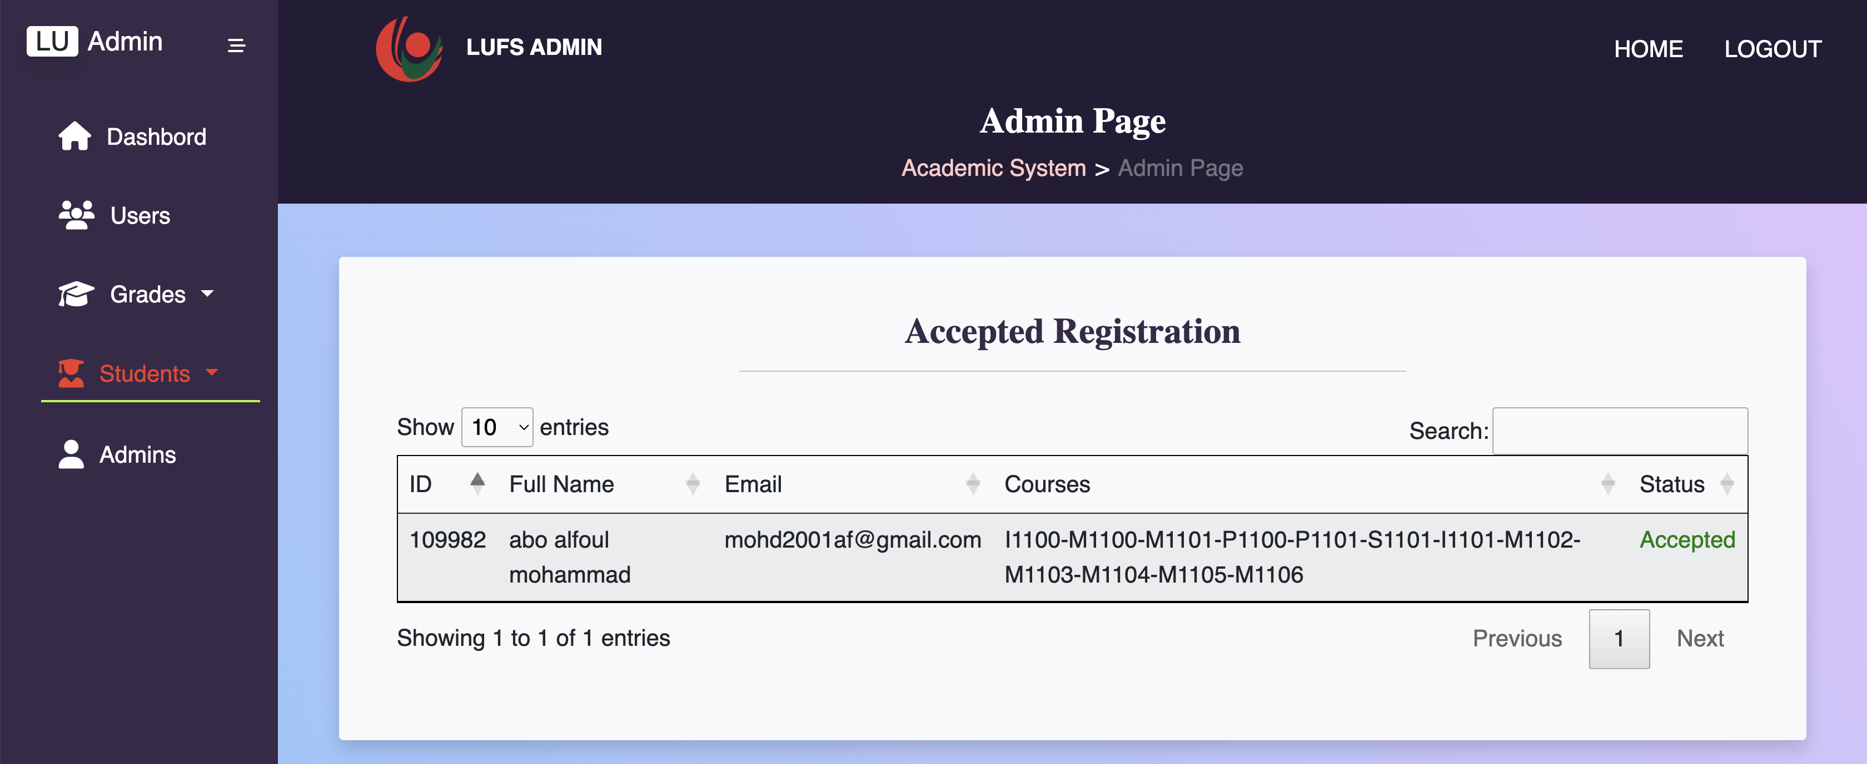
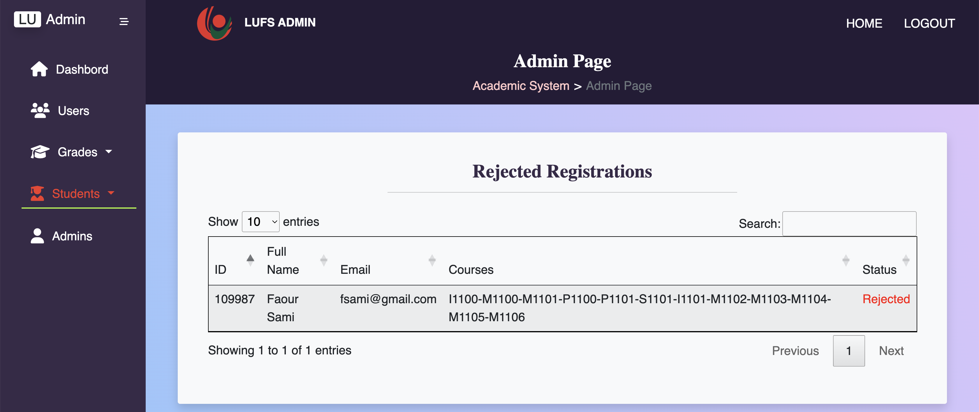
Admin Page – Student Course Registration Status
After an admin accepts or rejects a student-course registration request it will be displayed in separate sections to show accepted/rejected requests separately. Rejected requests will be hold on until a students choose appropriate or valid courses based in certain criteria.

Slide 23
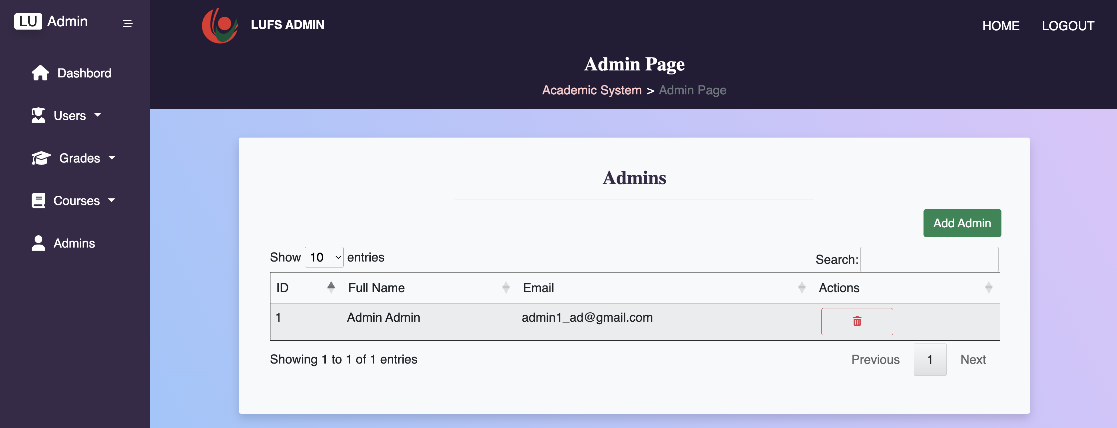
Admin Page – Display Admins
An admin will be able to display the list of admin accounts permitted to access the website as an administrator as well as add new admin.

Slide 24
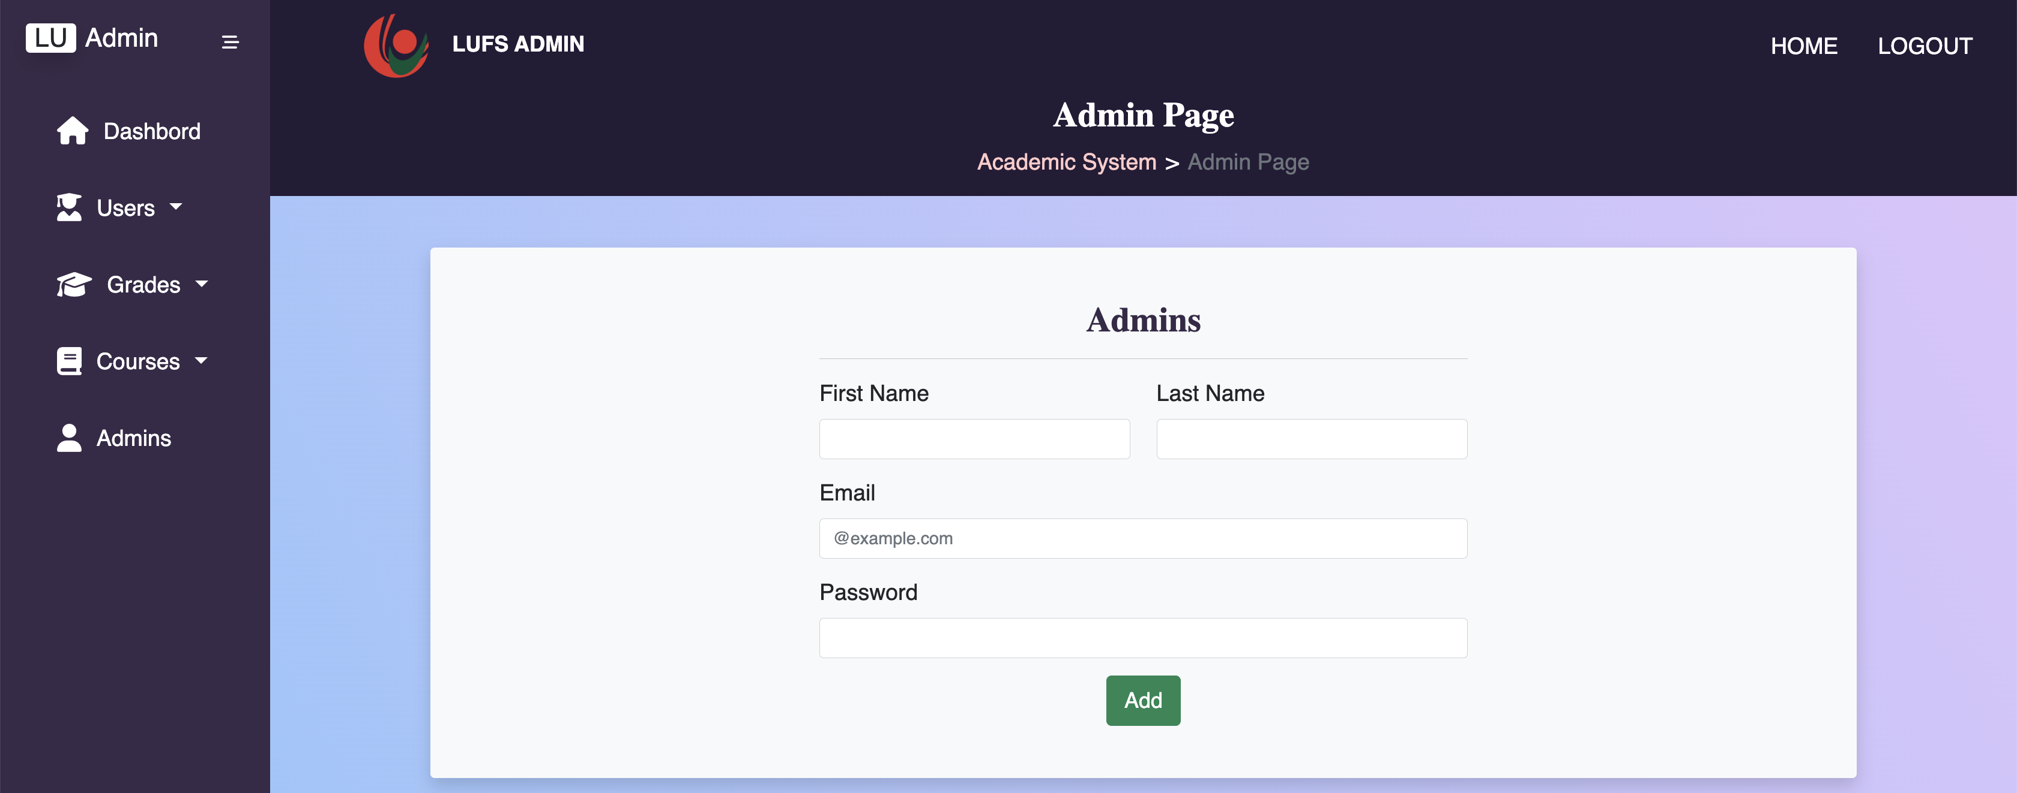
Admin Page – Add Admin
An admin will be able to add another admin account in order to manage students-course registration requests as well as assign grades.

Slide 25



Summary
Technology has been invading every aspect of our lives, nearly all sectors are depending on it to automate their services processes in order to reduce cost and time to full-fill these services. This advancement is crucially needed at the education level, and we LU Computer Science Masters’ Students developed this website to automate the process of registering students in courses online rather than having to complete this process in person, it reduces time and effort at both sides Students and Faculty Administration and perform these process in a simple, flexible, organized and effective way.

Slide 26




Thank you

